Slide 1

GROUP 3
Shreyas Mysore Narayana (2307777)
Azharmadani Syed (2316906)
Bala Srimani Durga Devi Chikkala (2290061)
Spoorthy Shivani Pabba (2157906)
Surya Vardhan Reddy Puchalapalli (2311061)
Bindhu Sri Chinta (2316879)
Guna Sekhar Siddabathuni (2312120)
Sai Supraja Ravi Kumar (2298302)
Dakshika Palanisamy (2313313)
Suchendra Reddy Yalamakuru (2313042)

Slide 2
Introduction
Background:
In the era of digital entertainment, users face overwhelming choices with vast movie libraries.
Finding relevant and personalized content quickly has become a major challenge.
Challenges with Traditional Systems:
Limited ability to handle sparse data and new users/movies (Cold Start Problem).
Repetitive recommendations with low diversity.
Lack of scalability for large datasets.
Project Goal:
To develop a hybrid movie recommendation system that:
Combines KNN (Collaborative Filtering) and
Association Rule Mining (ARM).
Provides personalized and diverse movie suggestions.
Ensures scalability and relevance for modern user demands.

Slide 3
Movie Recommendation
Dataset Preparation
Merging movies and rating datasets
Data Preprocessing
Filtering out the movies based on the recent user ratings (timestamp) column
Final Dataset
(Dataset size: 3.8M)
ML Algorithms: Matrix factorization (SVD, KNN (Cosine Similarity)), Collaborative filtering, Content based filtering, Deep Learning (Embedding based approach)
Model Building
Model Evaluation
Association Rule Mining: Apriori algorithm
Top 3 movie recommendations based on KNN and Apriori algorithm

Slide 4
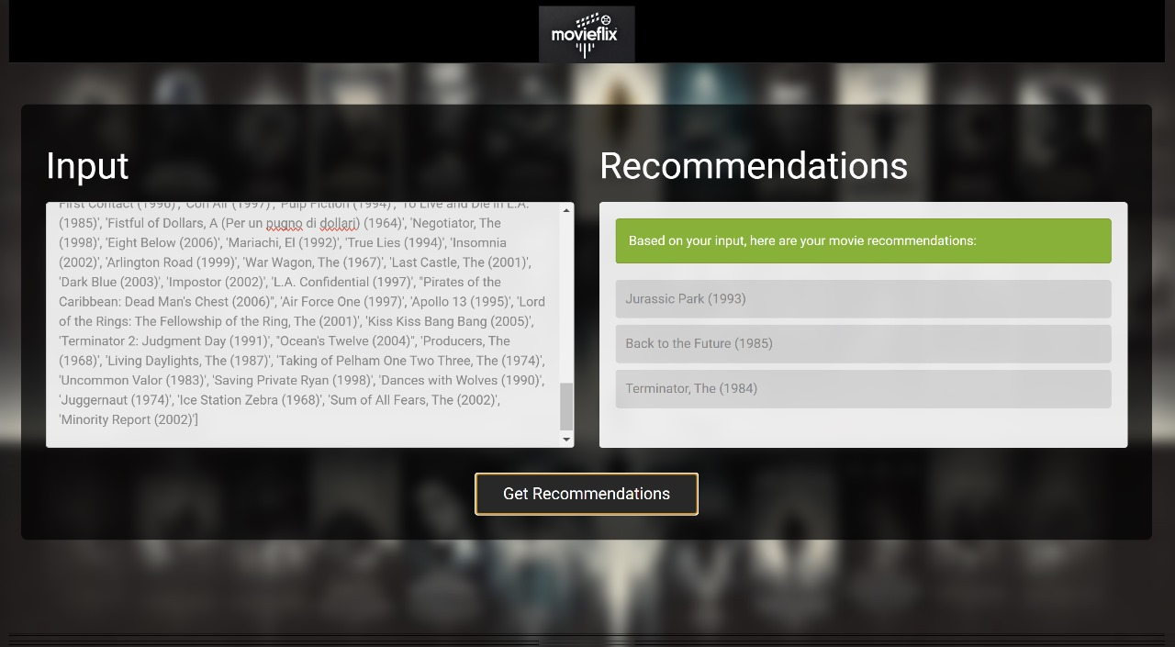
Movie Predictions

